Slide 1




Online
Examination
System
VIVEK SINGH ADHIKARI 10490302020
RAKESH KUMAR YADAV 06490302020 . PIYUSH UPADHYAY 35890302020
Major Project

Slide 2
INTRODUCTION
Online examinations contents providers to focus on creating effective assessment questions and focusing on exam’s feedback delivery to students. In the paper we present techniques that are pertinent to the elements of assessment process: answers submission, computerized grading, and feedback after submission. As the modern organizations are automated and computers are working as per the instructions, it becomes essential for the coordination of human beings, commodity and computers in a modern organization.

Slide 3
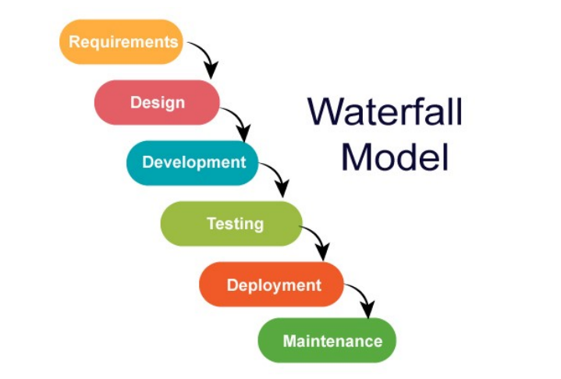
SOFTWARE MODEL USED

Slide 4
SYSTEM REQUIREMENT TOOLS
Software Requirements •
Tool -XAMPP •
Platform – Web Browser •
Technology – PHP, JavaScript, CSS, HTML, SQL 1.5.2
Hardware Requirements •
Windows / macOS •
Dual Core processor @ 1.00GHz •
2GB RAM

Slide 5
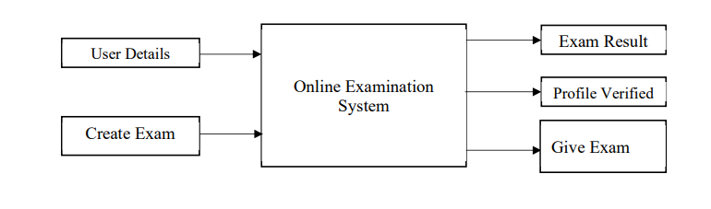
BLOCK DIAGRAM

Slide 6
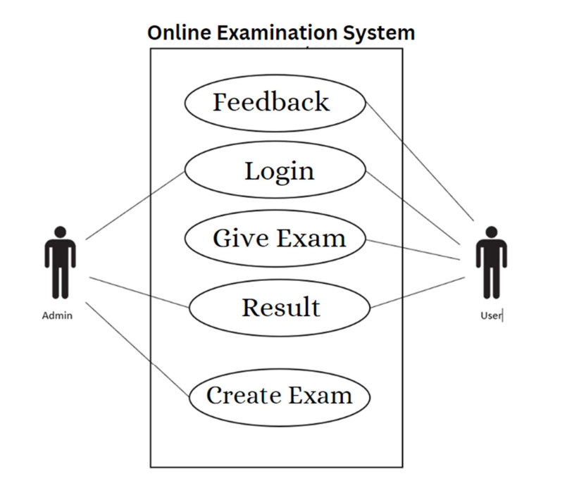
USE CASE

Slide 7
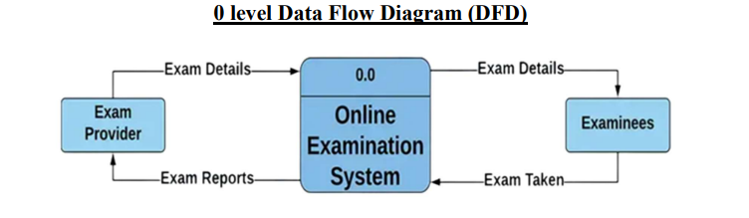
0 LEVEL DATA FLOW DIAGRAM (DFD)

Slide 8
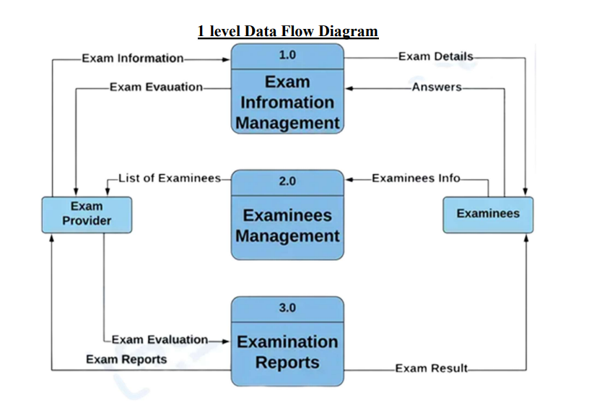
1 LEVEL DATA FLOW DIAGRAM (DFD)

Slide 9
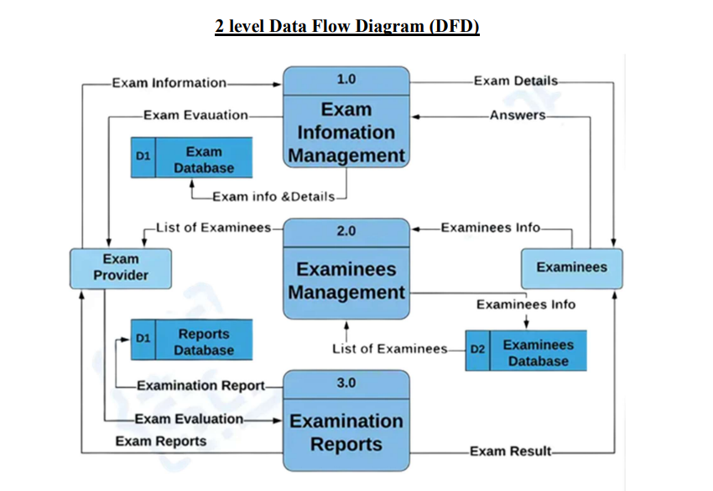
2 LEVEL DATA FLOW DIAGRAM (DFD)

Slide 10
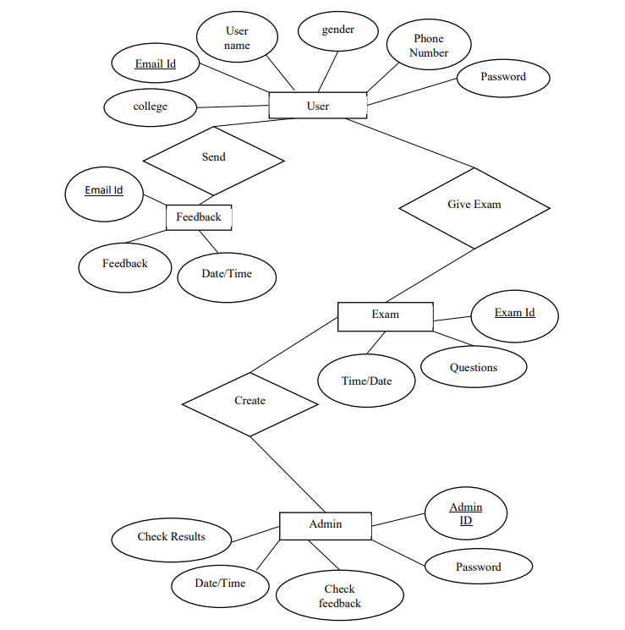
E-R DIAGRAM

Slide 11
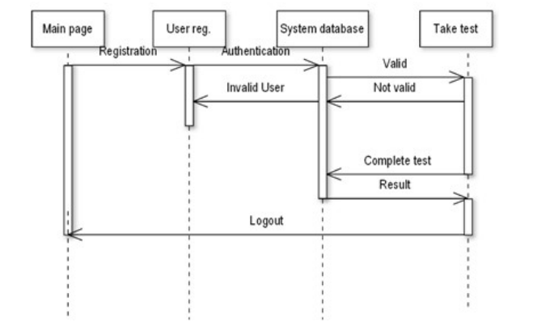
SEQUENCE DIAGRAM

Slide 12
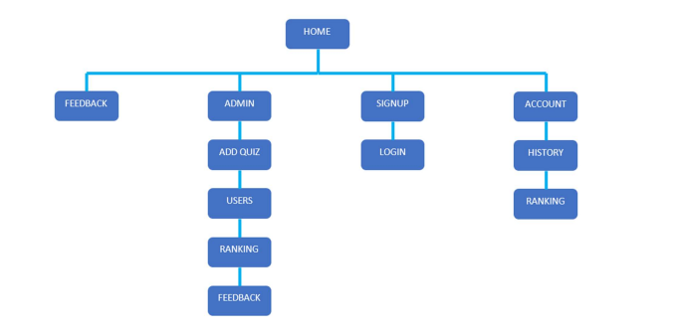
SITE MAP

Slide 13
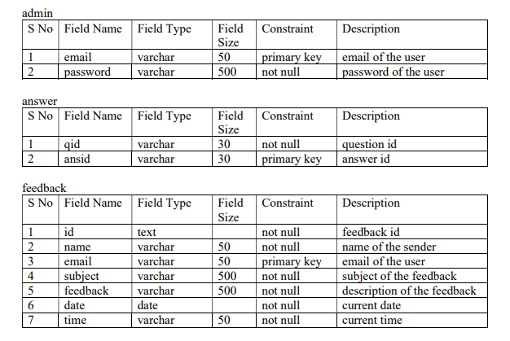
DATABASE DESIGN

Slide 14
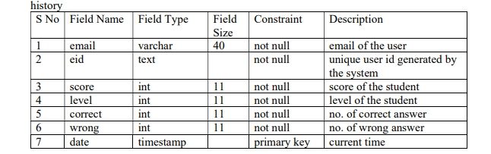
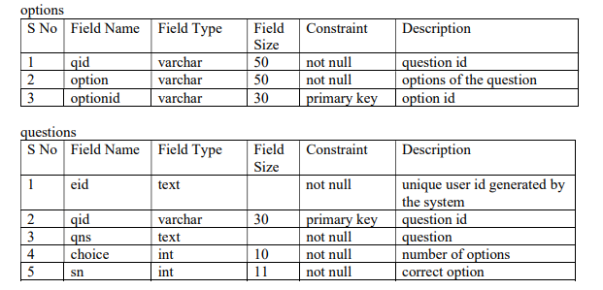
DATABASE DESIGN

Slide 15
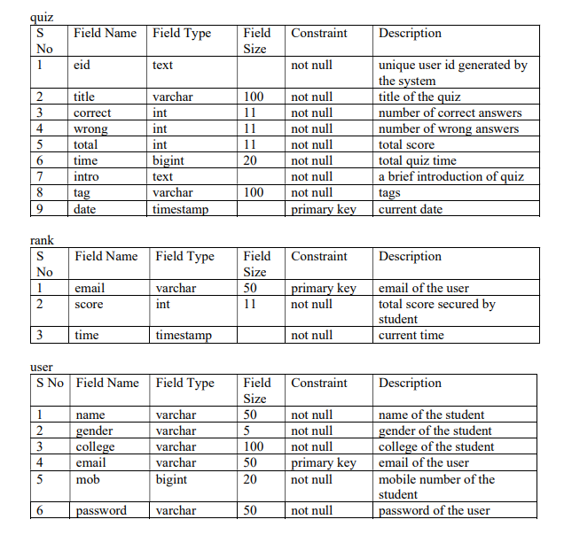
DATABASE DESIGN

Slide 16
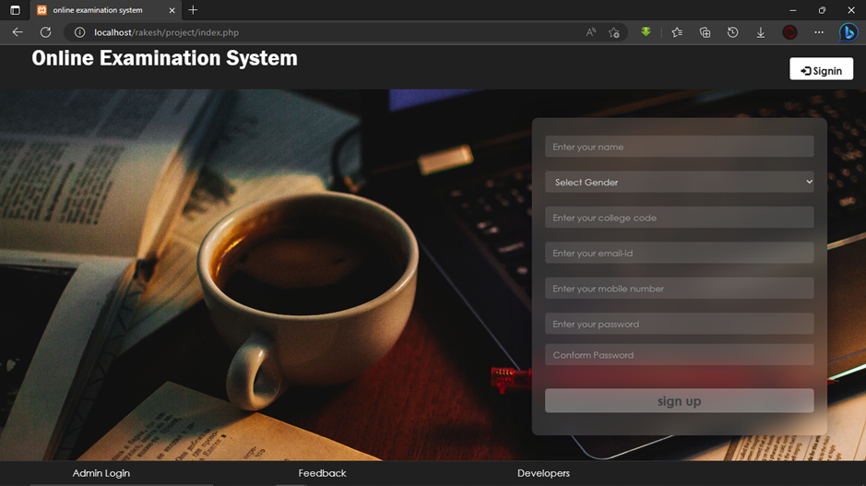
HOME
Home page is use to create new user by enter your Name, Select Gender (Male/Female), Enter College Code, Enter Email Id And user phone number, then create your password and reconfirm password for create new user.

Slide 17
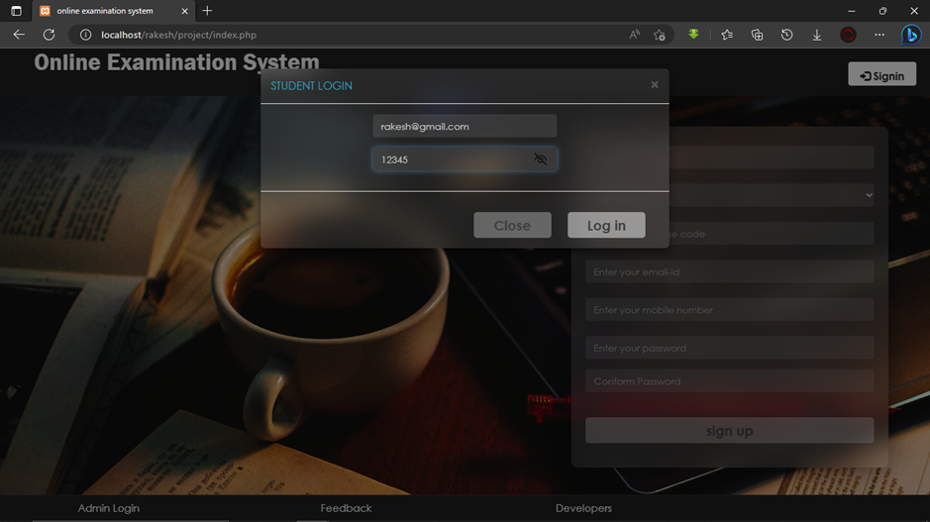
LOGIN
In login page, user can able to account login in website by entering email id and password which created in home page.

Slide 18
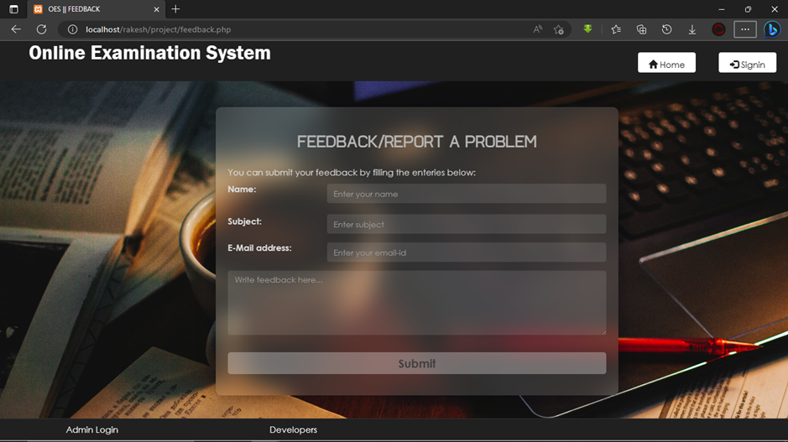
FEEDBACK
Feedback page is use to give feedback to admin directly by enter name subject of feedback and your valid email address and then enter your feedback.

Slide 19
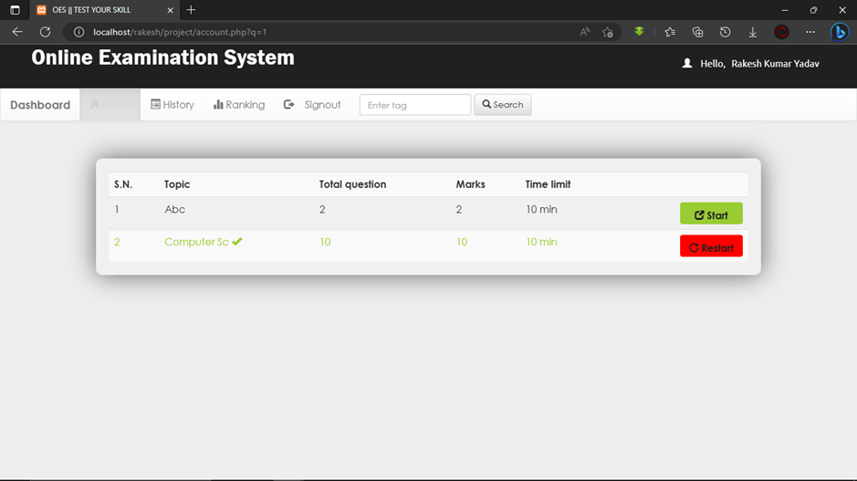
STUDENT DASHBOARD
In student dashboard, students are able to see their exam details.

Slide 20
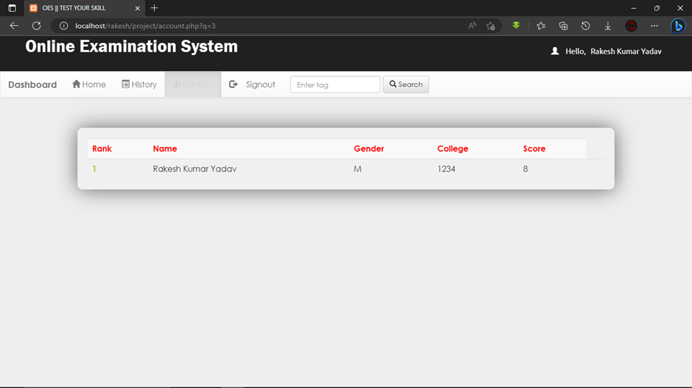
STUDENT RANKING
In student ranking, students are able to see their score of exams.

Slide 21
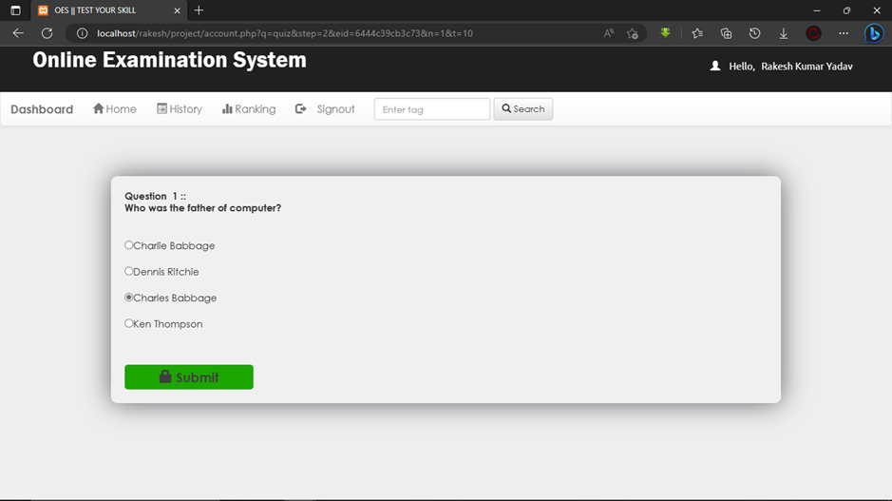
TEST QUESTIONS
In test page, the test will solve by the students.

Slide 22
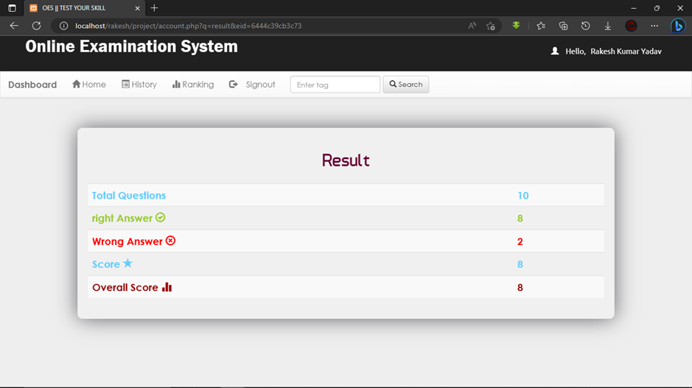
RESULT
In result page students are able to see their score and result of exam.

Slide 23
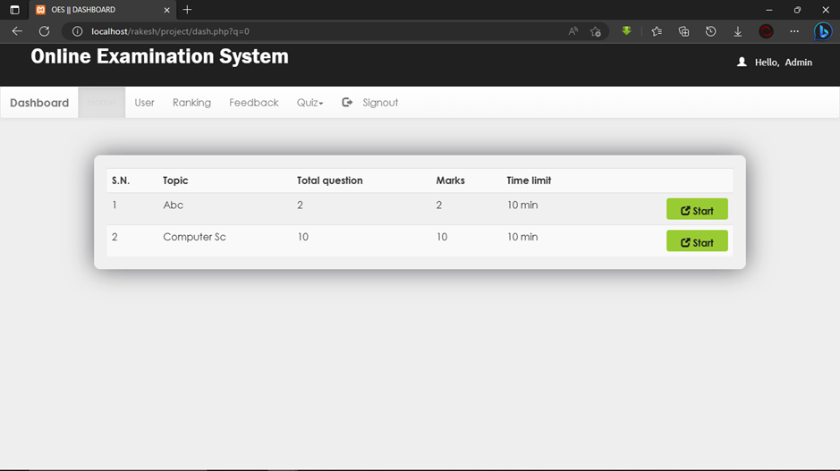
ADMIN DASHBOARD
Admin Dashboard is managed by admin, create exam and manage the exam.

Slide 24
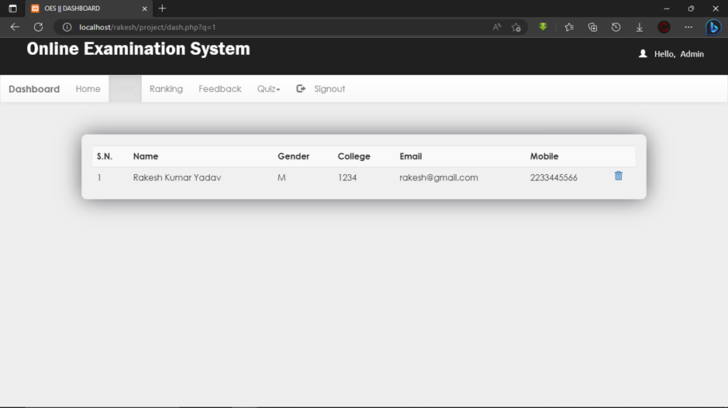
USER LIST
All the users are listed here, it can be accessed by admin

Slide 25
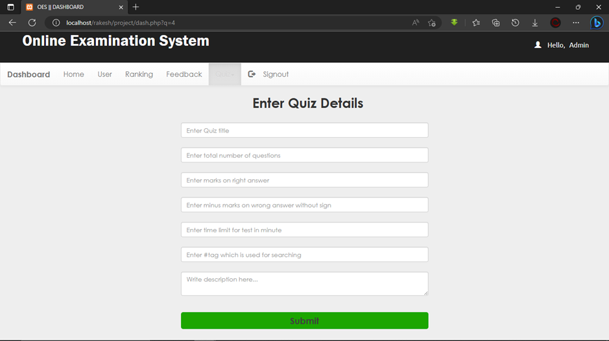
ADD QUIZ
Exam is created by admin.

Slide 26
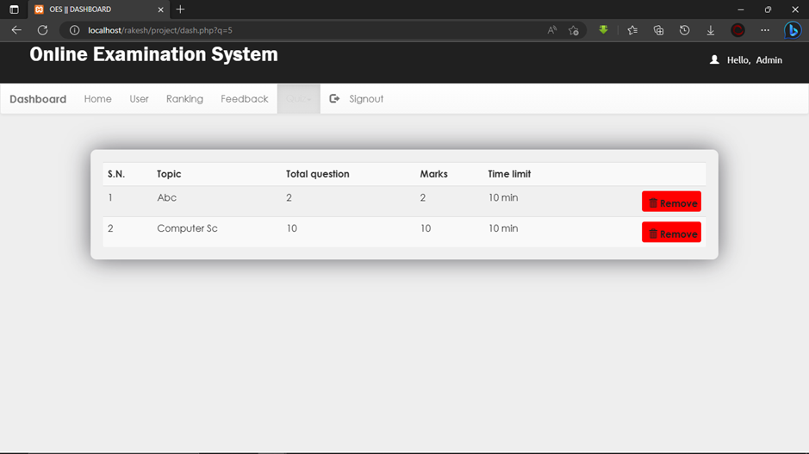
REMOVE QUIZ
Created exam can be removed by admin.

Slide 27
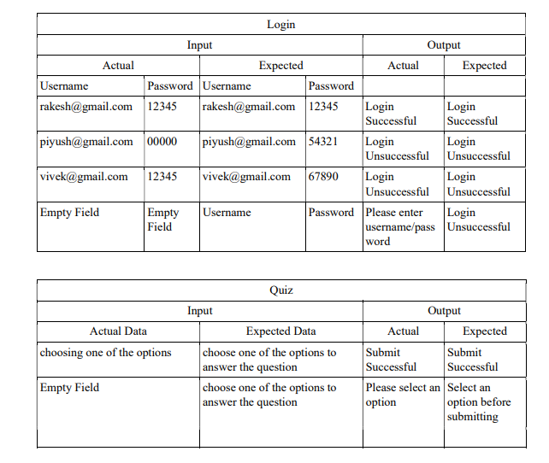
SYSTEM TESTING

Slide 28
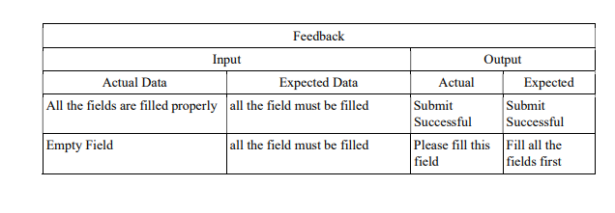
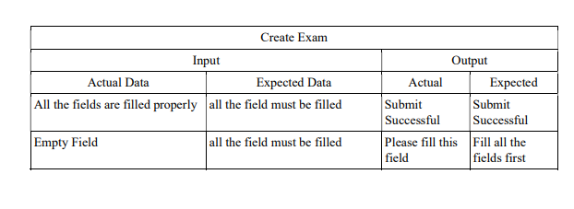
SYSTEM TESTING

Slide 29
SCOPE
The online examination system application is vast. It can be used in various sectors, schools, colleges, tuition centers, or individual tutors. It replaces the logistical problems and shortcomings of the conventional pen-and-paper examination mode. It will also reduce the usage of paper and ink. It will save the time which is used in scheduling the exam and improve the management.

Slide 30
THANK YOU
VIVEK SINGH ADHIKARI 10490302020
RAKESH KUMAR YADAV 06490302020 . PIYUSH UPADHYAY 35890302020

